Slide 1
User interface design

Slide 2
UI Design: Wed Week 6
Dr. Jillian Aurisano
Plan for today:
Methods for human centered design
Notes:
So welcome to engineering visual interfaces for data science. I'm Dr Aurisano.
Thanks for finding the class on Zoom. Hopefully we will be in person again soon.
If anyone out there is comfortable turning on their cameras, that is lovely- then I feel like I am talking to students, rather than to myself.
Here’s our plan for today:
First I’m going to introduce myself, so you know a bit about me
Then we are going to get to know each other, in Zoom breakout rooms. This will give us a chance to make sure that Zoom breakout rooms work, and we all know how to access them.
Then, I am going to walk through the structure, and plan for the course. I want to make sure everyone knows how the course will work, and what to expect, and also a bit about why the course is designed this way.
Then I am going to introduce the class, and what the class is about. Since this is a new class, and one of just a few classes in human centered computing here at UC, I wanted to give an overview of the topic.
Then I have an introductory activity, which we will do in breakout rooms, and which I think will help motivate the discussion on Wednesday, and getting into the meat of the class.

Slide 3
Project 2
Questions?

Slide 4
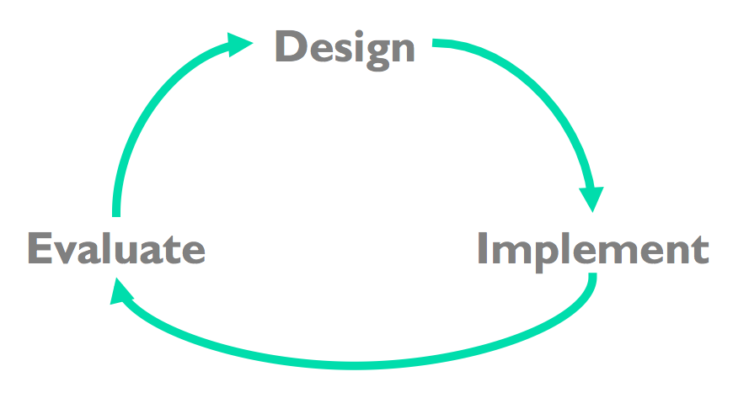
User-Centered Design
Early focus on users and tasks
Constant evaluation to inform new design choices
Evaluation with lightweight prototypes

Slide 5
How do we enter the cycle?
Needs finding, understanding our users

Slide 6
Human-centered design phases
Pre-design
Before creating something
Needs finding / Requirements gathering
Identify the goals of the interface
Formative evaluation
During the process of designing, informing the design
Summative evaluation
At some ‘end point’ to assess your design
All such studies have to go through an ethical review process (more on that later)

Slide 7
Some examples:
Observing work practices at an organization- “field setting”
Interviews or focus groups with potential users of an interface
Exploratory study in a lab, recording how people use a mock-up prototype of a device
Survey with questions about current practices and challenges
System logs with usage data from a previous design iteration
Eye tracking data, for a design iteration
Recording time and errors in completing a task

Slide 8
Steps
Ethics
Study design- choosing an approach that will allow you to learn what you need to learn
Piloting- testing your study design
Recruitment- getting the right people
Recording- capturing what you need to have for analysis
Analysis- translating your recordings into insights, findings, directions

Slide 9
Ethics and Human-Subjects research
All research involving people* must go through some form of ethical review at your institution
What is research involving people
If you are recording or documenting the activities of people as data
You can collaborate with people- not human subjects research
But if you are reporting out data from people- interviews, studies, documenting work practices- you need to go through an ethical review

Slide 10
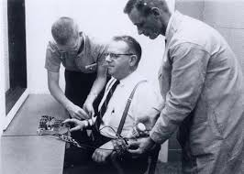

Why ethical review?
History of bad practices by researchers in studies involving people.
Stanford Prison Experiment
Milgram Experiment

Slide 11
Qualitative vs Quantitative methods in human-centered computing
Qualitative methods: Capture and analyze qualitative data (text descriptions, images…).
Findings that can’t be summarized with statistics
Interview transcripts, Video recordings of someone using an interface where they are instructed to ‘think aloud’ as they use it, Observing practices in a workplace
Quantitative methods: Capture data that can be analyzed with statistics or visualized in standard charts
Survey, time and errors measurements, eye tracking, testing different conditions A vs B for performance of tasks
Is one better than the other?

Slide 12
Qualitative methods are important in user-centered design
Respondents to our survey scored this an average of 2.1 on a learnability assessments (out of 5)
What do we think?

Slide 13
Qualitative methods are important in user-centered design
Respondents to our survey scored this an average of 2.1 on a learnability assessments (out of 5)
In interviews participants described their learning strategies for an interface
”I had to ask my co-worker for help several times over my first year using the software.”
“I was able to remember what steps to take by making a post-it-note system, to store the actions in a list”
Several interview participants mentioned that they did not attempt a task, because they did not think it was worth the time to figure out how to do it.
What does the qualitative data add?

Slide 14
Qualitative methods are important in user-centered design
Respondents to our survey scored this an average of 2.1 on a learnability assessments
Observational study where participants used the interface for 30 minutes, and used a ‘think-aloud’ protocol to express their thoughts as they interact
Ok, I think I need to find the menu where these settings are in place, perhaps here, no I think I need to go back a step.
So, I found the submenu where this is located. Now let’s see if I should hit submit, no wait I think it wanted me to first enter the target value up here, how do I go back?
What does the qualitative data add?

Slide 15
Qualitative methods are important in user-centered design
Depth of what you can report
Why is there a learnability problem?
What is the impact of this problem?
What support strategies could help?
Typically some qualitative information enriches our understand of the problem at hand.

Slide 16
Qualitative methods are important in user-centered design
Spontaneous insights
You may not know what to measure quantitatively
Qualitative data can help identify needed measures for future quantitative studies

Slide 17
Semi-structured interview
Interviewing people about their experiences, their practices, their needs
Gathering needs and roadblocks
What is ’semi-structured’
You have a set of questions
But can follow-up freely based on what interviewees say
Example:
Interviews to understand roadblocks sharing data and models in data science teams
Interviews to understand challenges for students trying to balance work and school assignments
What do you have at the end:
Transcript
“Artifacts” from the discussion- was anything referenced or displayed as a discussion point?

Slide 18
Other qualitative methods: Observation
Watching people work or interact with technologies
Can be performed in a laboratory setting- controlled scenario
Also ‘in the wild’ – real world setting
Gain an understanding of what people do (vs what they say that they do)
Complement with interviews to make sense of what is observed
Examples:
In the wild- observing how parents interact with their phones while kids play on playgrounds
In the lab- observing how multiple people make a decision using a new software tool to support collaborative data analysis
Video, transcript

Slide 19
Other qualitative methods: Think aloud
Think aloud
Users talk through thoughts while interacting with a system or solving a problem
Understanding how people perceive and experience a system and how they use it to support their work
Example
Ask people to use a new UI for banking. They are instructed to ”think-aloud” as they try to accomplish their tasks

Slide 20
Other qualitative methods
Focus groups
Facilitating a group discussion between people with similar background or about the theme or technology of interest
Gathering experiences from more than one person at a time
Potentially greater breadth and less depth
But note- risk of group-think
Diary studies
Participant maintains a dairy of relevant activities, actions, experiences, reflections
But may be superficial unless participants are very committed

Slide 21
Note about interviews
Conversational
Ask why, ask follow-ups
Maintain neutral tone
This can be hard to do
What were your interviews for the previous project like?

Slide 22
You can apply qualitative methods to a variety of contexts
Laboratory setting, with recruited participants
Observation in the field- in a real world setting
You can use multiple methods, to compliment your results
You can use qualitative methods with quantitative methods

Slide 23
Recruitment
Studies complex problems, in close to real-world settings
Opportunity for depth and realism
But…
Small-ish numbers of participants
So- to generalize and know your findings are reliable, you need to think about recruitment-
who are you observing or talking to
Suppose you were designing an application for students- how to recruit?
Suppose you were designing an application for data analysts- how to recruit?

Slide 24
Analysis
Record video or audio
Preserve artifacts (like notes or things users created in the study)
Transcribe, and/or capture relevant snapshots from video
And then what?
How do I pull out data from transcripts and images?

Slide 25
Thematic analysis
Sometimes you have the coding scheme in advance, but often you develop up it in response to what you notice in your study
Grounded theory- develop an approach analyze your data based on the data itself
How:
Review the data
Identify interesting themes
This may be something you are interested in prior to running your study
Or this may be something that emerges from the data
Sticky-notes (virtual or physical) to cluster statements into themes
May also develop a ‘code-book’, as themes are formalized into codes

Slide 26
Let’s do an example together
Go to Canvas, check under modules

